Slide 1
Week-5
ArduPilot MAVLink
MAVSec: Securing the MAVLink Protocol for Ardupilot
YouTube Videos:
https://www.youtube.com/watch?v=q7g02kvfJoU

Slide 2
MAVLink
It is a very lightweight messaging protocol for communicating with
drones and between onboard drone components.
The protocol defines a large set of messages.
The messages are not guaranteed to be delivered which means
ground stations or companion computers must often check the state
of the vehicle to determine if a command has been executed.
Messages are no more than 263 bytes.

Slide 3
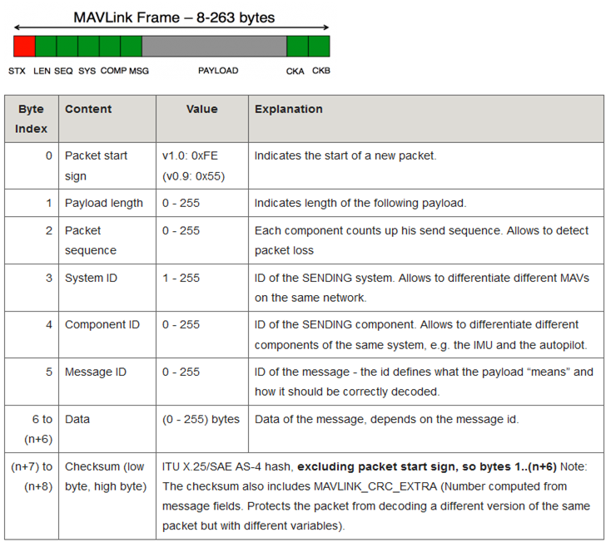
MAVLink Frame

Slide 4
MAVLink
MAVLink message types are identified by the ID field on the packet
and the payload contains the appropriate data.
Once a connection is opened each device (aka “System”) sends the
HEARTBEAT message at 1hz.
MAVLink 2 allows 24 bit message ID.
MAVLink 2 adds support for message signing, which allows a MAVLink
system to verify that messages originate from a trusted source.

Slide 5
MAVLink Routing in ArduPilot
ArduPilot (which runs on the flight controller) can route MAVLink messages
received on one telemetry port to all other telemetry ports.
Some messages include target_system and target_component fields to allow
specifying which system/component should execute the command.
A value of 0 for the target_system or target_component is considered a broadcast
ID.
All received MAVLink messages are checked by the MAVLink_routing class.
This class form an array map between channel and <sysid,compid> pair.
Messages that don’t have a target <sysid,compid> are processed by the vehicle
and then forwarded to each known system/component.

